Slide 1
Data Meeting: Crystallization in Systems of Hard Polyhedra
Richmond S. Newman, Sharon C. Glotzer

Slide 2
Publications
1. Role of isostaticity and load-bearing microstructure in the elasticity of yielded colloidal gels. Lilian C. Hsiao, Richmond S. Newman, Sharon C. Glotzer, Michael J. Solomon. (2012) PNAS, 109(40), 16029–16034.
Performed molecular dynamics simulations to help quantify the role of rigid clusters on gel rheology
2. Shape-Driven Colloidal Crystal-Crystal Transitions Xiyu Du, Greg van Anders, Richmond S. Newman, Sharon C. Glotzer. PRL. In review.
Advised Xiyu on carrying out this project and provided the bulk of the analysis code enabling this research
3. Size- and Shape-Controlled Synthesis of Doped LiYF₄ Upconversion Nanophosphors and their Shape-Directed Self-Assembly Xingchen Ye, Joshua E. Collins, Richmond S. Newman, Michael Engel, Jun Chen, Guozhong Xing, Cherie R. Kagan, Sharon C. Glotzer, and Christopher B. Murray. JACS, in preparation.
Contributed Monte Carlo simulations and provided two mechanisms, truncation or attraction, to explain observed assemblies
4. Shape-Dependent Ordering of Gold Nanocrystals into Large-Scale Superlattices Jianxiao Gong, Richmond S. Newman, Michael Engel, Sharon C. Glotzer, Zhiyong Tang. Nature Nano, submitted.
Contributed simulations and understanding of the homogeneous and heterogeneous nucleation growth of their gold nanopolyhedra, and understanding of the defects and competing structures inherent to the building blocks
5. Comparing nucleation of rhombic dodecahedra and spheres. Samanthule Nola, Richmond Newman, Julia Dshemuchadse, Sharon C. Glotzer. PRL, in preparation.
Contributed calculations of thermodynamic driving forces, free energy barriers to nucleation for each shape, and potentials of mean force and torque of each structure, probing how different shapes lead to different crystallization phase behavior.
6. Influence of polyhedral faceting on the crystallization of rotator cubic close packings Richmond Newman, Julia Dshemuchadse, Sharon C. Glotzer. PRL, in preparation.
Performed calculations showing how a continuous change in shape-parameter effects the nucleation barriers and local fluid and solid structures of a continuously changing family of hard polyhedra.

Slide 3
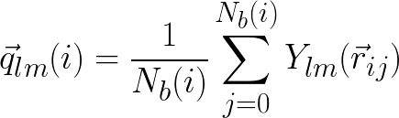
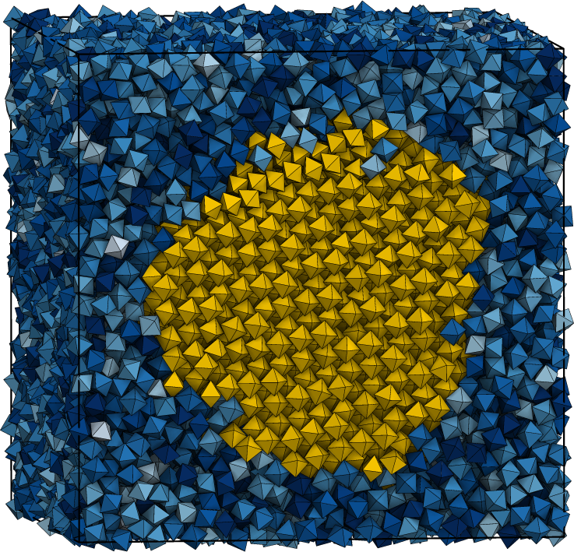
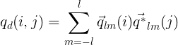
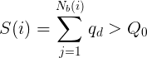
Methods: Finding Crystals from Simulation
Cluster particles i if
Wolde, P. Ten, Ruiz-Montero, M., & Frenkel, D. Faraday Discuss. 1996
Notes:
“Briefly before we begin I wish to discuss some methods that are important, and that I spent time implementing for our research group to share and reuse” Mention other upgrades of the group analysis code with this, fixing, then eventually reimplementing the periodic boundaries/domain decomposition for performance

Slide 4
Methods: Rare Events: Umbrella Sampling
Biased Monte Carlo Ensemble
Sample nuclei
sizes
ten Wolde’s method
Correct statistics gathered under bias
Compute Free Energy
Auer, S., & Frenkel, D. J. Chem. Phys. 2004
Notes:
Consider explaining this slowly, particularly how the ubias/ and acceptance probabilities are calculated upon a system.

Slide 5
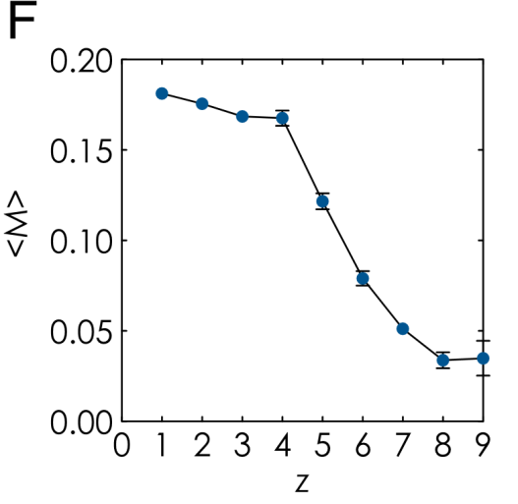
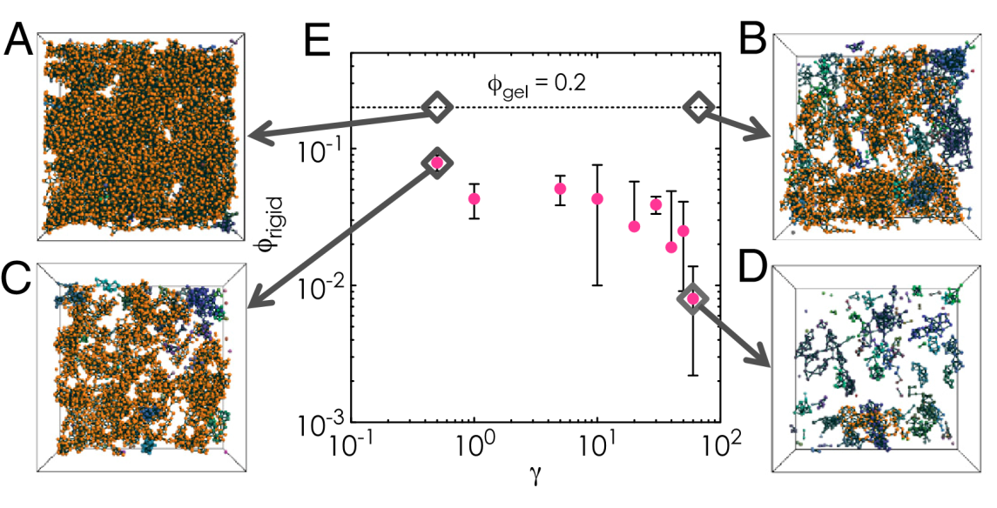
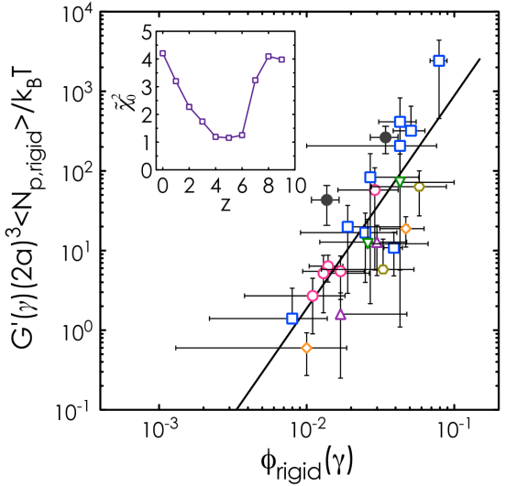
Paper 1
Role of isostaticity and load-bearing microstructure in the elasticity of yielded colloidal gels. Hsiao, L. C., Newman, R. S., Glotzer, S. C., & Solomon, M. J. (2012) PNAS, 109(40), 16029–16034.
Performed molecular dynamics simulations to help quantify the role of rigid clusters in gel rheology
Helped quantify role of contact number and rigidity via simulation using an angular mobility and shape descriptor order parameters

Slide 6

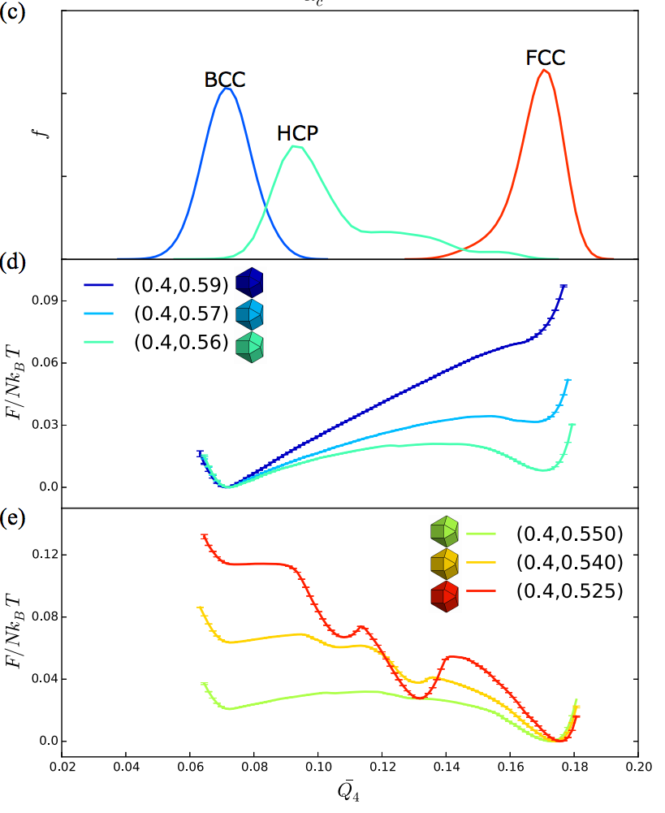
Paper 2
Shape-Driven Colloidal Crystal-Crystal Transitions Xiyu Du, Greg van Anders, Richmond S. Newman, Sharon C. Glotzer. PRL. In review.
Role in project
Advised Xiyu on carrying out this project
Provided a large portion of the analysis code and methods
Local bond order parameters
Helped Xiyu implement additional order parameters
Wrote code for Umbrella Sampling with HOOMD-blue
Project Accomplishments
First order phase transition discovered between family of face centered cubic and body centered cubic forming polyhedra (right)
No phase transition between cubes and vertex- truncated cubes from simple cubic to BCC
Each ‘shape’ adopts a new ‘stable’ crystal structure
More examples in paper – but shape driven phase transitions may be first order, or not a phase transition at all

Slide 7
Paper 3
Size- and Shape-Controlled Synthesis of Doped LiYF₄ Upconversion Nanophosphors and their Shape-Directed Self-Assembly Xingchen Ye, Joshua E. Collins, Richmond S. Newman, Michael Engel, Jun Chen, Guozhong Xing, Cherie R. Kagan, Sharon C. Glotzer, and Christopher B. Murray. JACS, in preparation.
Project Accomplishments
Contributed Monte Carlo simulations with a fairly minimal model explaining the experimentally observed structures of parallel and antiparallel striped motifs, body centered tetragonal, and a rolled-parallel phase using a simplified model of the system
Mapped phase diagrams determining regions describing where each equilibrium structure forms

Slide 8
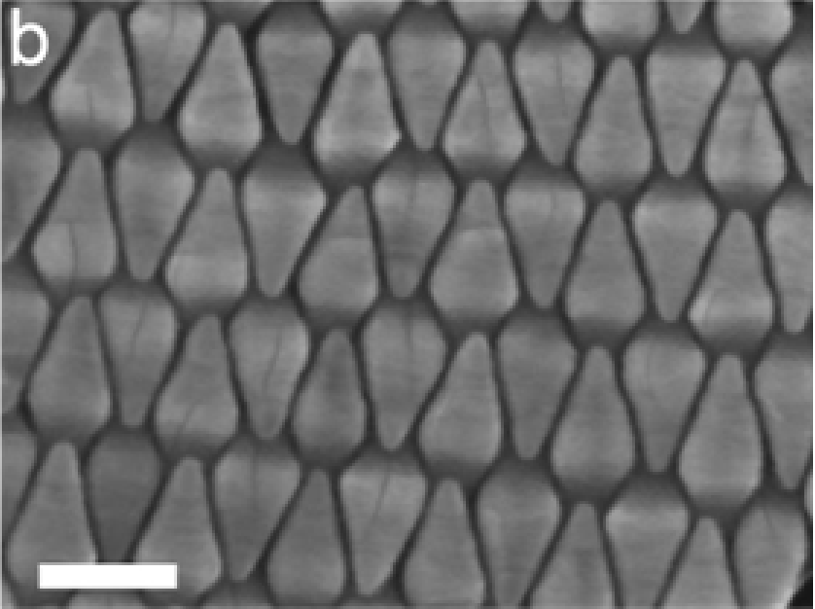
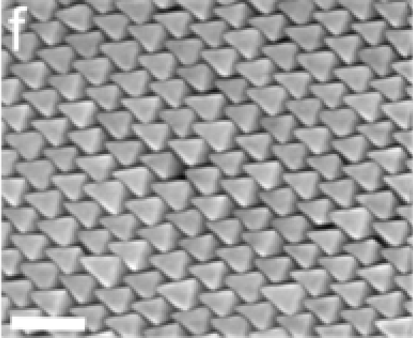
Primary goal
Understand driving forces for LiYF₄ bipyramids particles on a 2D interface to assemble either parallel or striped phases
100nm
100nm

Slide 9
Simulation Model
Model as hard polyhedra in Monte Carlo
Vertices (±1,0,0),(0, ±1,0),(0,0,±A)
Need to confine particles to be quasi-2D
Apply stiff harmonic spring for vertices outside a narrow window (k_{z}=100, 𝛿_{z}=0.7)

Slide 10
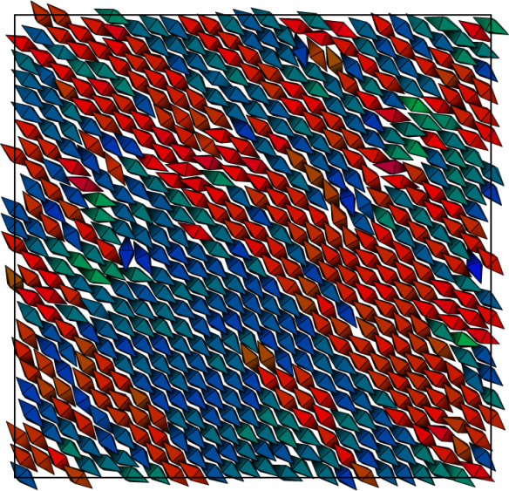
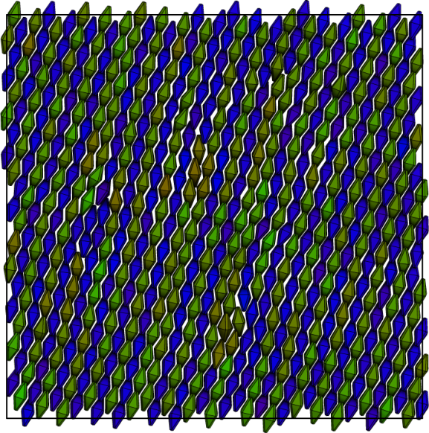

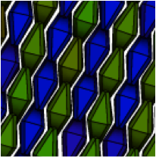
Example assemblies

Slide 11
Phase Diagrams

Slide 12

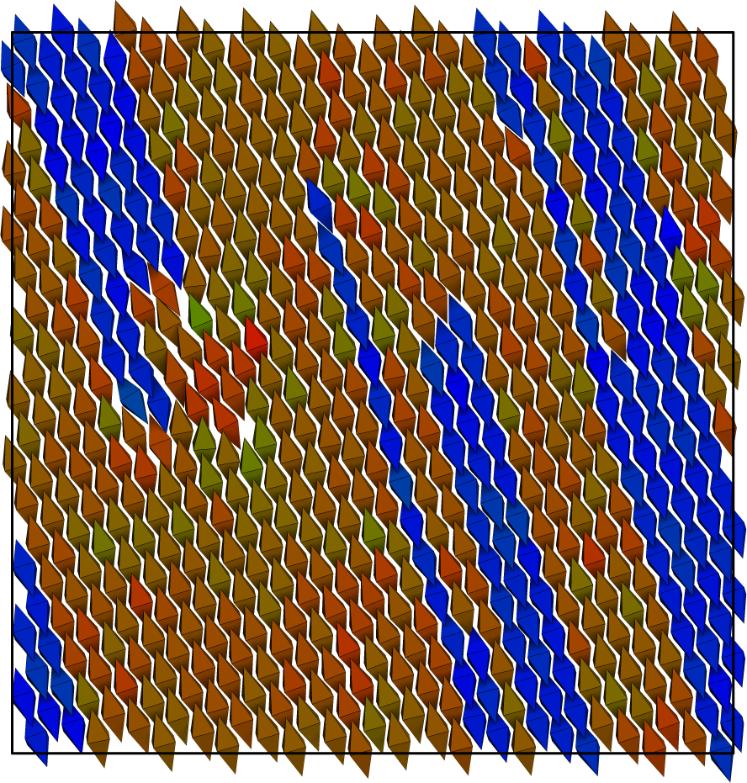
100nm

Slide 13

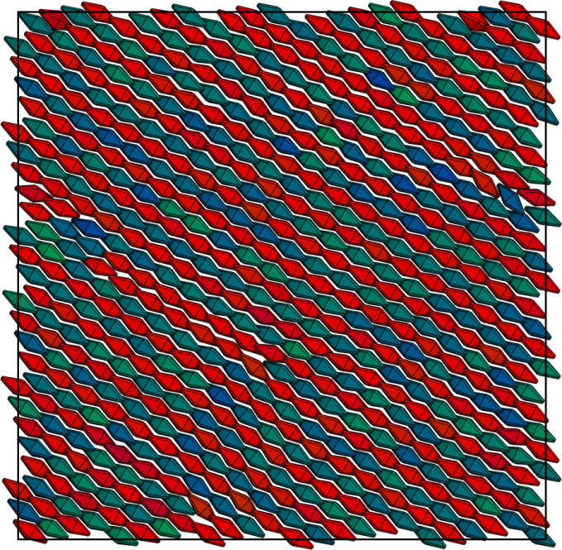
100nm

Slide 14
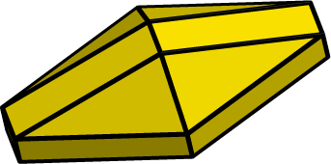
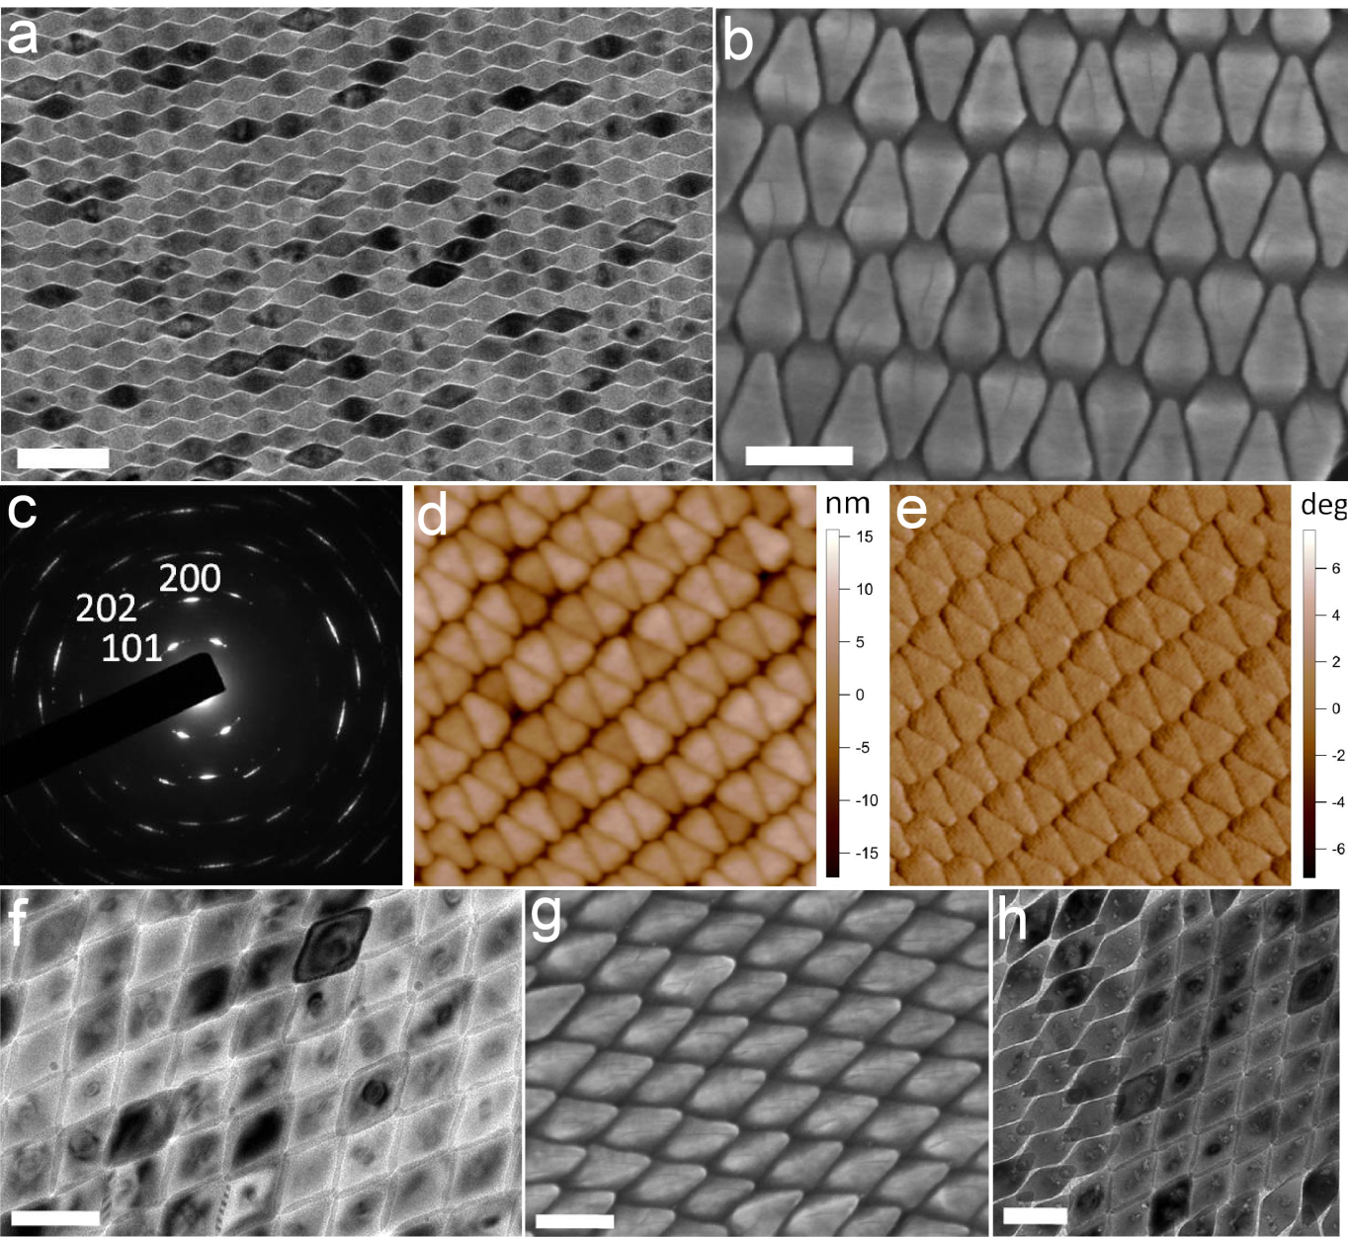
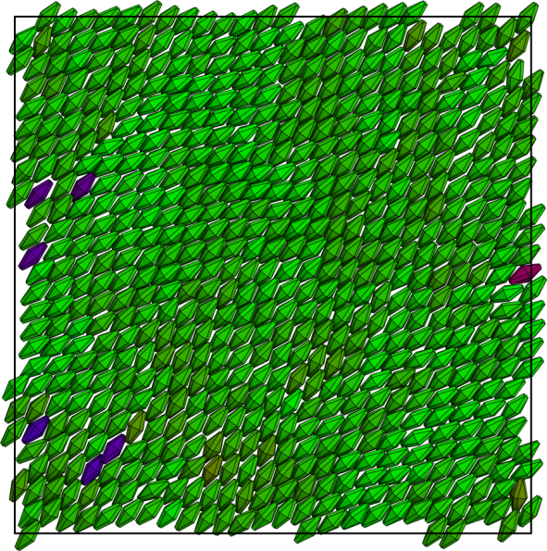

Slide 15

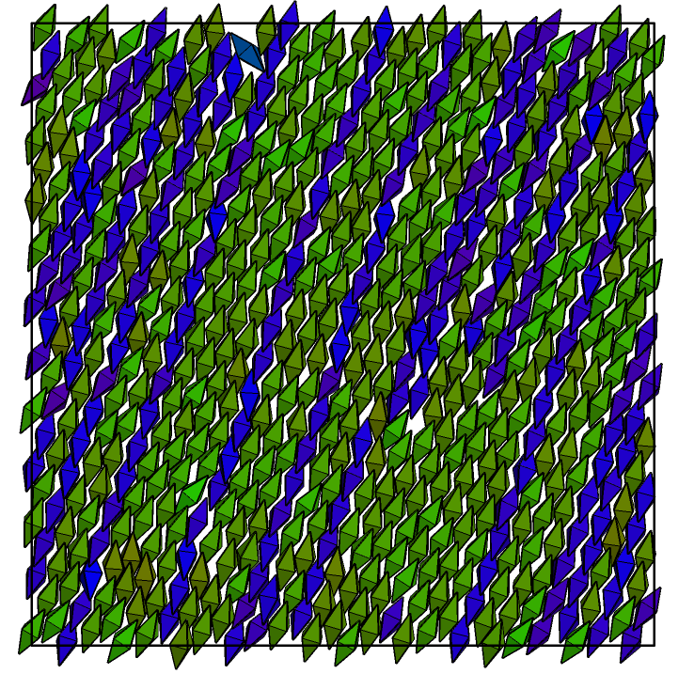

Slide 16
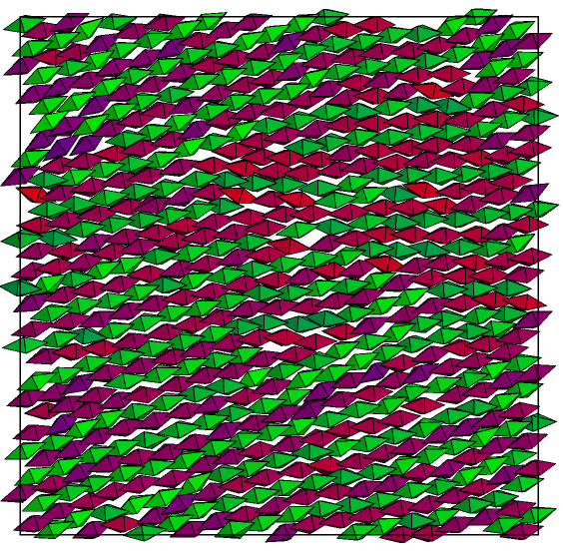

Slide 17
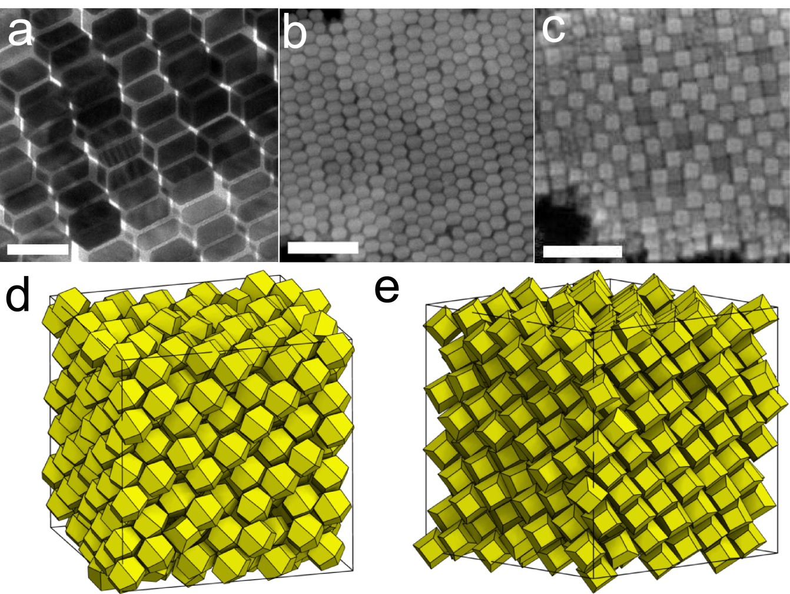
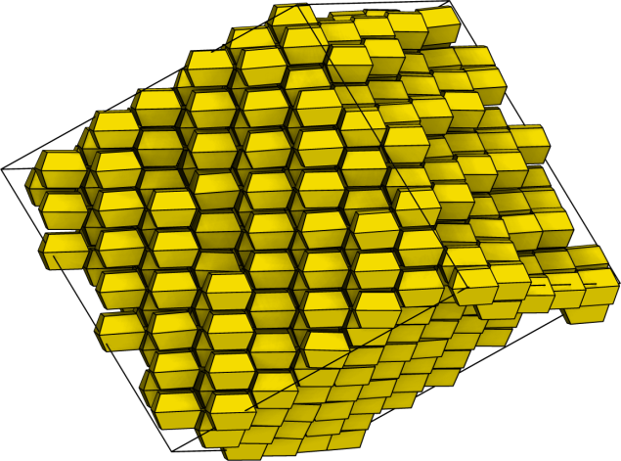
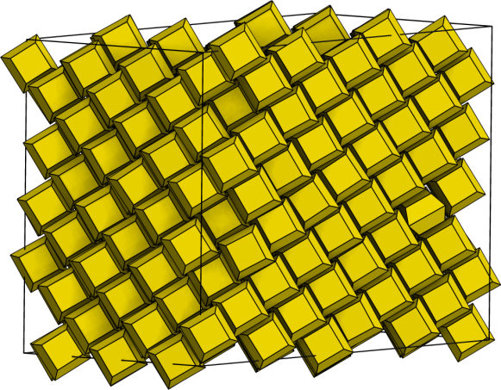
Tip truncations
Body centered tetragonal assemblies
Note: 3D structures

Slide 18
Conclusions: Paper 3
Truncation or short ranged attractions both stabilize the formation of the antiparallel phases
Good parallel phases arise from shorter aspect bipyramids
A second parallel arrangement occurs for heavily truncated bipyramids which roll over
Mimics behavior of rounded bipyramids in SEMs
Heavily tip truncated bipyramids assemble multi-layer BCT structures instead of monolayers.

Slide 19
Paper 4
Shape-Dependent Ordering of Gold Nanocrystals into Large-Scale Superlattices. Jianxiao Gong, Richmond S. Newman, Michael Engel, Sharon C. Glotzer, Zhiyong Tang [Nature Nano 2016, submitted]
Project Accomplishments:
Explained the crystallization processes for of each synthesized gold nanopolyhedra
Identified and motivated the presence of several octahedron superlattices
Probed effects of heterogeneous nucleation on the crystal structures and their stability
Aided in understanding the formation process and quality of the resultant structures

Slide 20
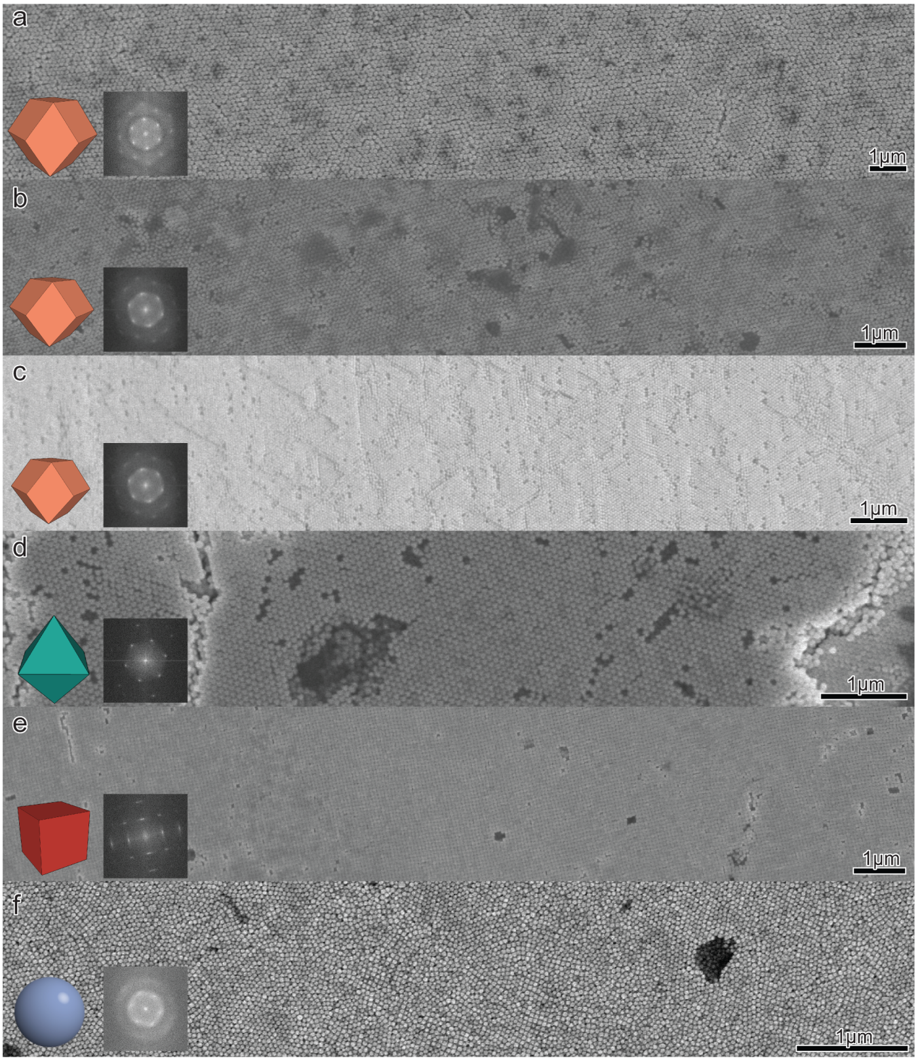
Large, high quality superlattices

Slide 21
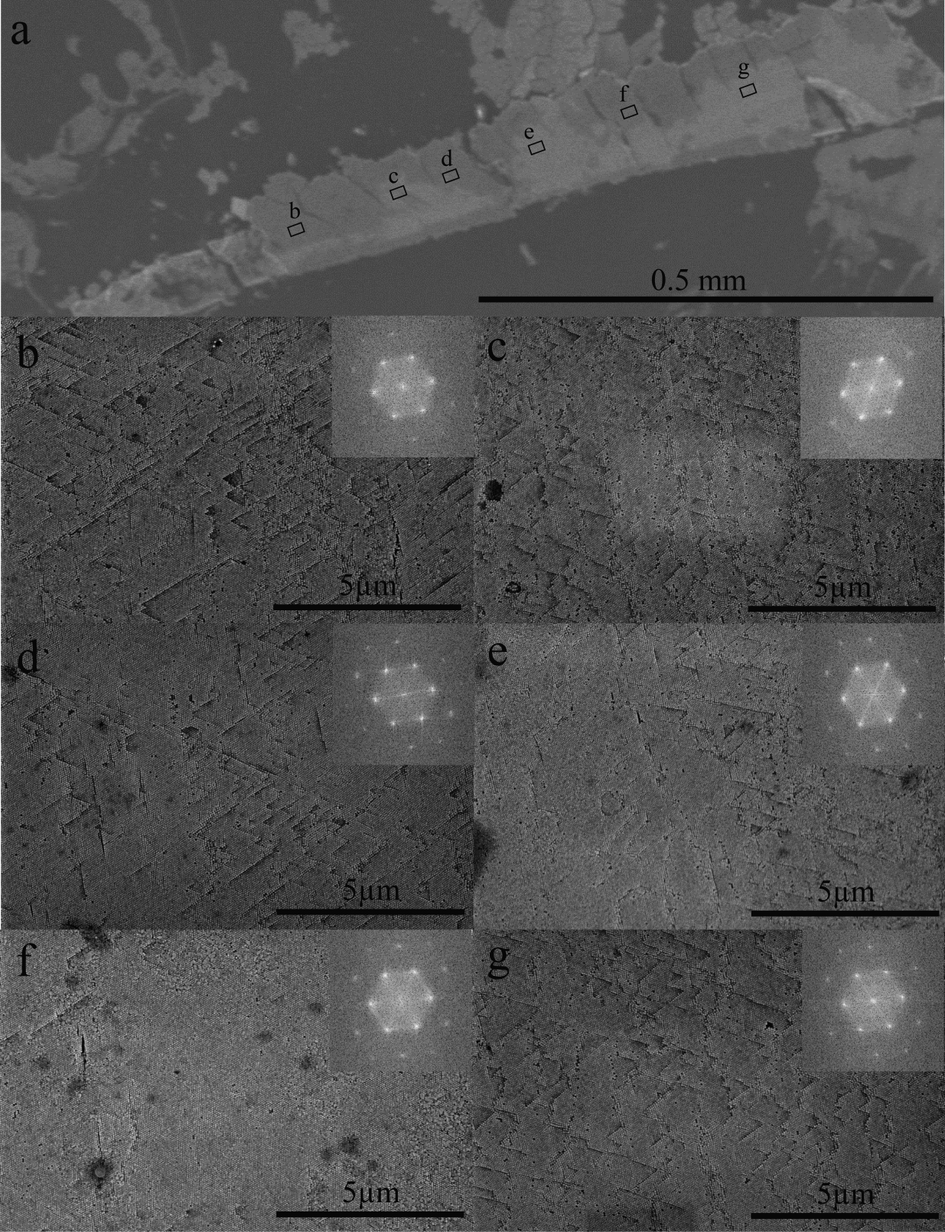
Millimeter-scale
Same diffraction orientation across sample

Slide 22
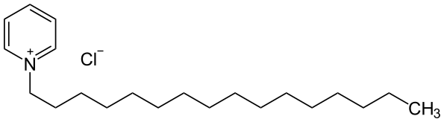
Methods (Experimental)
Gold nanopolyhedra ~30nm edge lengths
Stabilized with CPC (Cetylpyridinium Chloride)
Solvent: Water (mostly)
Particles sediment

Slide 23
Equilibrium NVT Phase Behavior
Simulations (NVT, Hard particle MC). Equilibrium behavior averaged over 10 replicates of 50e6 MC sweeps. N=2048 particles.
Rhombic dodecahedra and cubes more ‘robust’

Slide 24
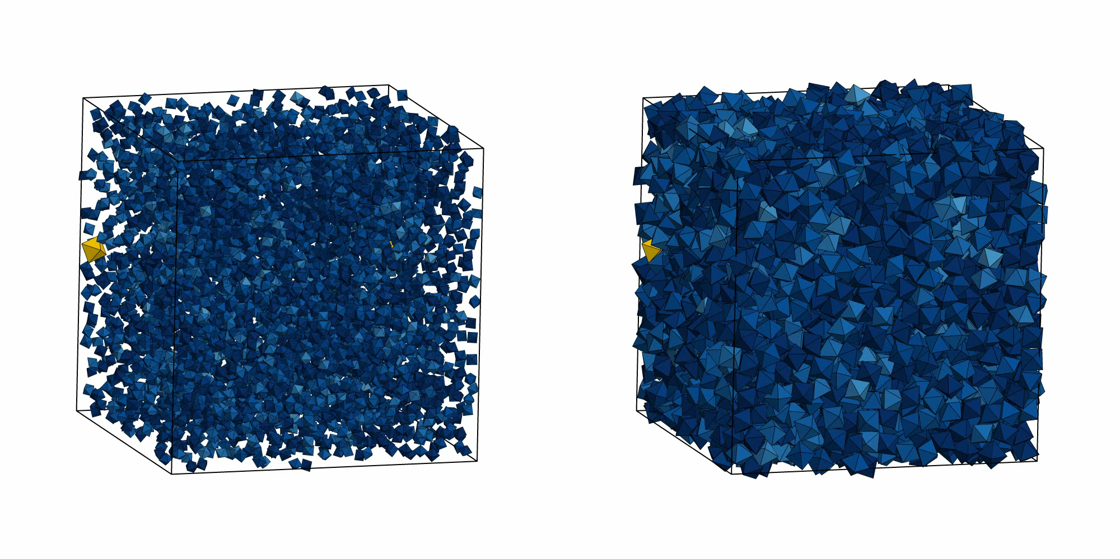
Nucleation

Slide 25
Typical Homogeneous Growth

Slide 26
Crystallization timescales

Slide 27
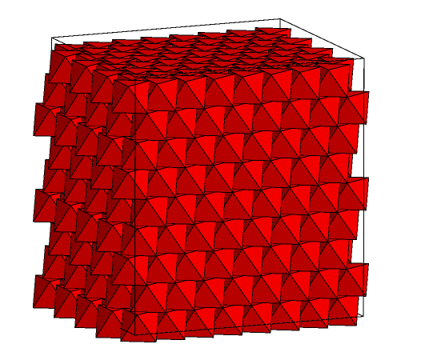
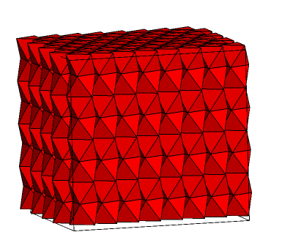
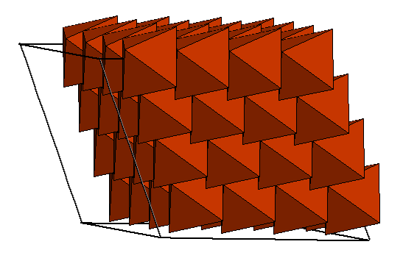
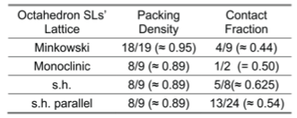
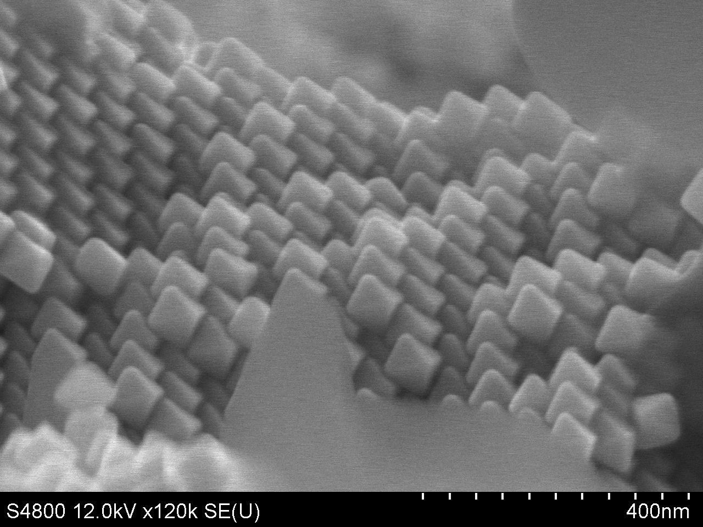
Identification of octahedra superlattices
Minkowski
Monoclinic
Hexagonal
Notes:
Mention the three (Minkowski/trigonal, Monoclinic, and hexagonal). Discuss the relative stability (Hard particle access first two).
Discuss hexagonal structure.

Slide 28
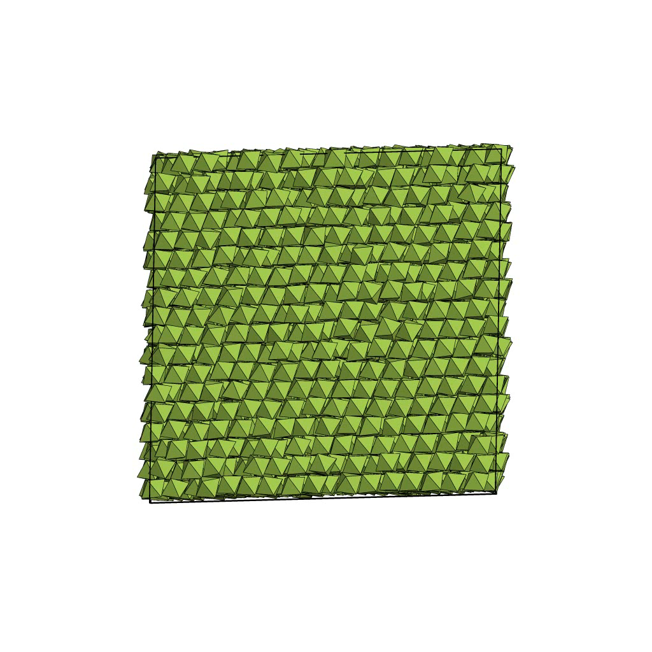
A solid-solid phase transition

Slide 29

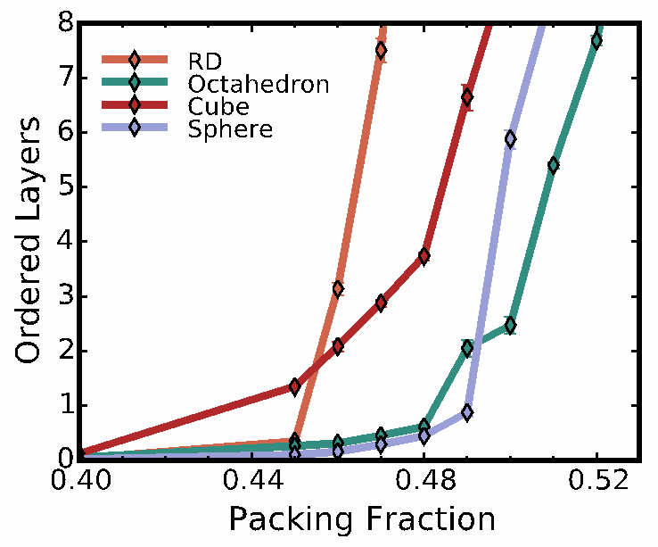
Heterogeneous Nucleation
Notes:
Spheres 51%

Slide 30
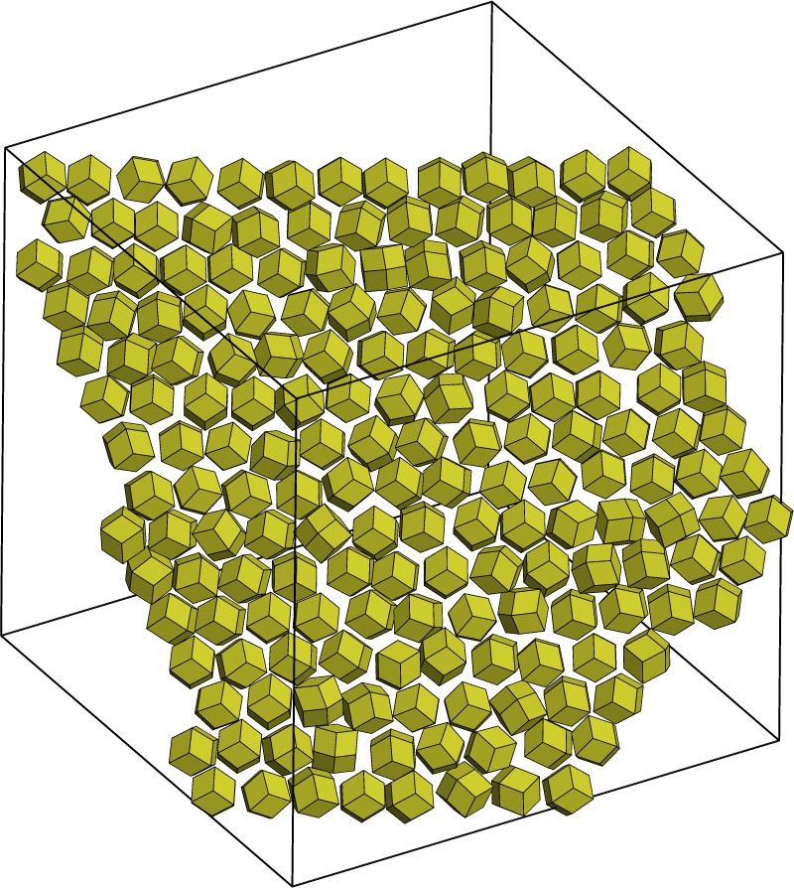
RD: Orientational disorder

Slide 31
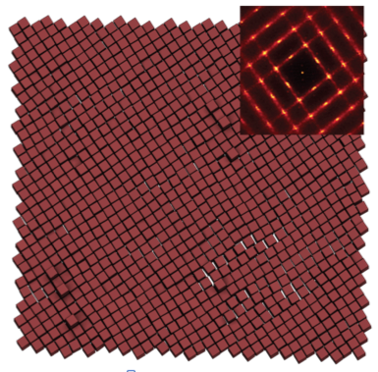
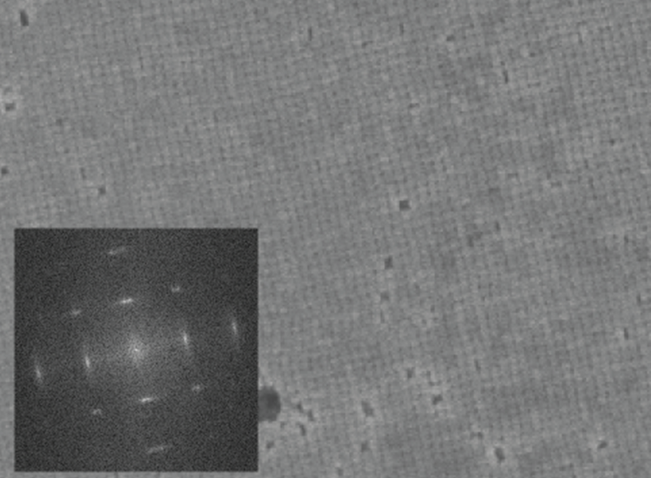
Cubes: Correlated disorder

Slide 32
Conclusions: Paper 4
Octahedra structure affected by heterogeneous nucleation control and sedimentation favoring Monoclinic packings
Structural Quality
Rhombic dodecahedra assemble under wide equilibrium conditions but may have orientational defects
Cubes nucleate easily, but suffer from high vacancy content and local positional disorder
Octahedra superlattices order well, but with polymorphic equilibrium structures

Slide 33
Moving onwards
So far we mostly discussed equilibrium hard particle phase behaviors, with some direct measurements of nucleation rates
How does particle shape affect the nucleation processes and thermodynamics of transitioning from fluid to solid?

Slide 34
Paper 5
Comparing nucleation of rhombic dodecahedra and spheres Samanthule Nola, Richmond Newman, Julia Dshemuchadse, Sharon C. Glotzer. PRL, in preparation.
Contributed calculations of thermodynamic driving forces, free energy barriers to nucleation for each shape, and potentials of mean force and torque of each structure, probing how different shapes lead to different crystallization phase behavior.
Project Accomplishments
Compared direct measurements of precritical clusters in the fluid
Computed chemical potentials for hard rhombic dodecahedra and free energy barriers; find that spheres are significantly harder to nucleate
Investigate role of shape on the transition from fluid to solid, not merely the equilibrium structure by computing and comparing potentials of mean force and torque in both fluid and solid phases

Slide 35
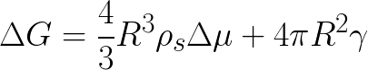
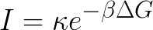
Classical Nucleation Theory

Slide 36


Thermodynamics

Slide 37
Small particle clusters in the fluid
Pressure?

Slide 38
Small particle clusters in the fluid
Shown against driving force

Slide 39
Free Energy Barriers

Slide 40
Free Energy Maxima

Slide 41
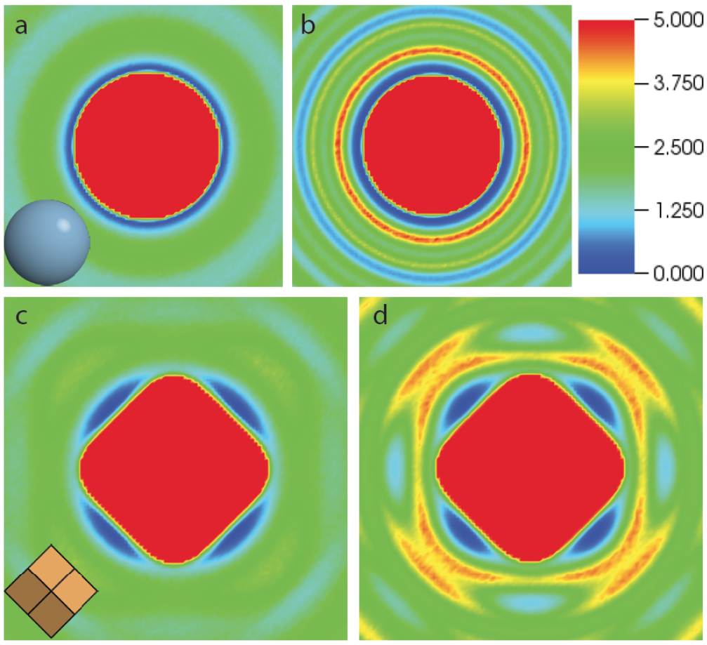
Potential of Mean Force & Torque

Slide 42
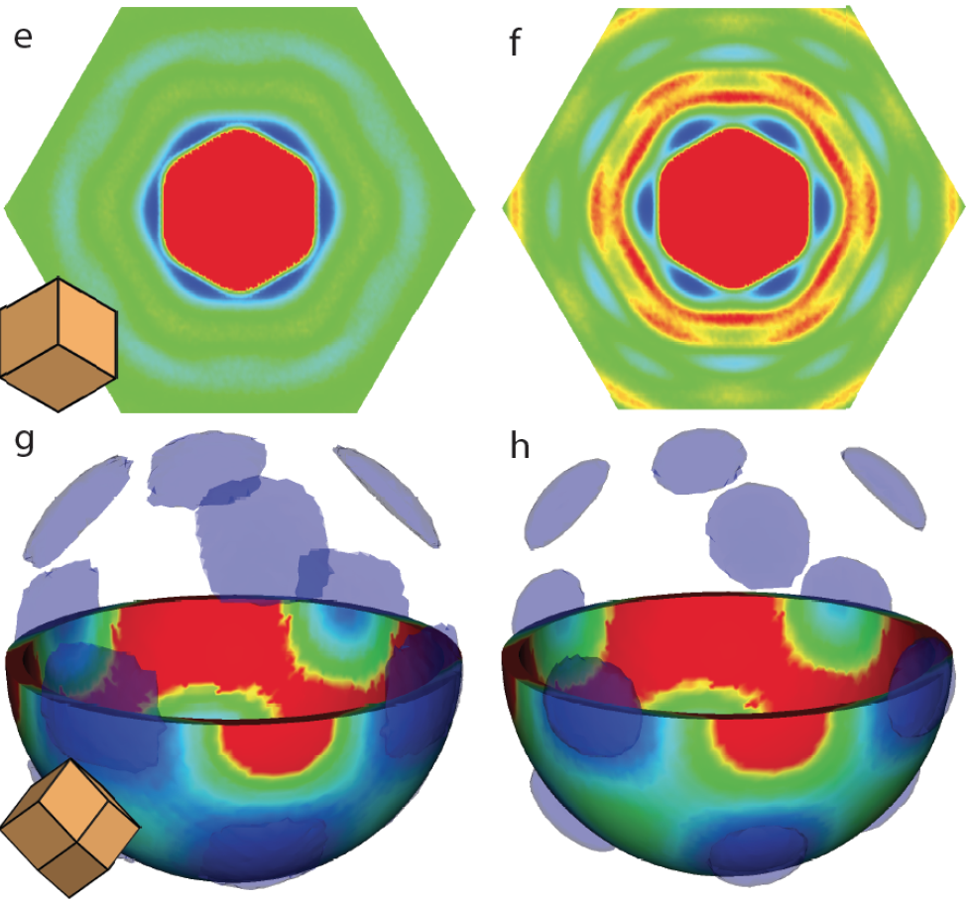
Potential of Mean Force & Torque

Slide 43
Conclusions: Paper 5
Shape anistropy allows directional entropic forces between particle pairs to exist in the fluid and these forces manifest at moderate supersaturations
Cluster size distribution increases faster for RD in fluid
Nucleation barriers required (at given driving force) is roughly 20kT lower.
Recall, nucleation rate ~exp(-ΔG/kT).
We suggest the benefit of additional local orientational ordering in the fluid in transitioning to the solid

Slide 44

Paper 6
Influence of polyhedral faceting on the crystallization of rotator cubic close packings Richmond Newman, Julia Dshemuchadse, Sharon C. Glotzer. PRL, in preparation.
Performed calculations showing how a continuous change in shape-parameter effects the nucleation barriers and local fluid and solid structures of a continuously changing family of hard polyhedra.
Project Accomplishments
Demonstrated how a continuous change in shape affects nucleation behaviors in hard particle systems
Investigated how altered faceting changes local ordering

Slide 45
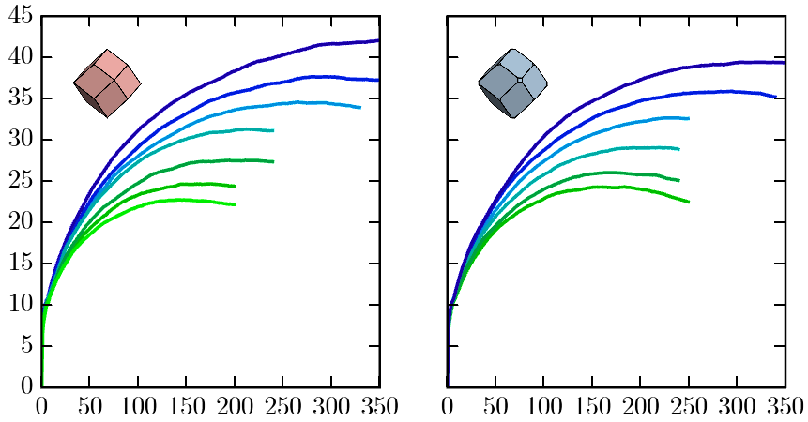
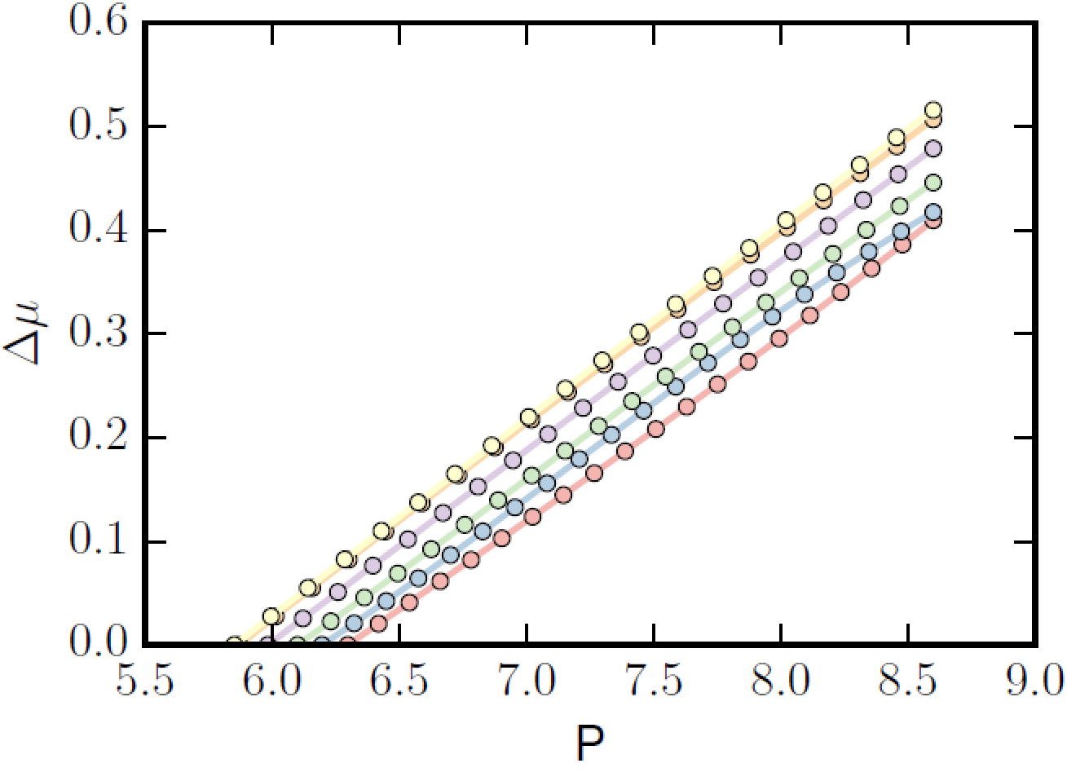
Free energy Maxima & Cluster Sizes
βΔG
Cluster Size

Slide 46
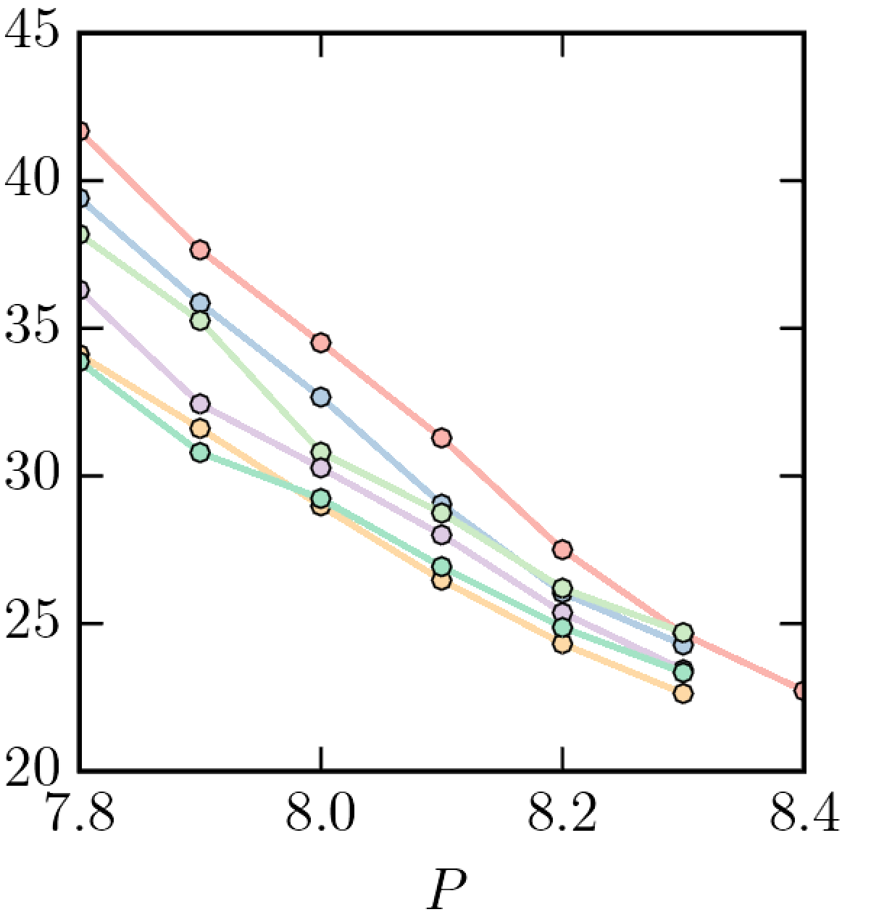
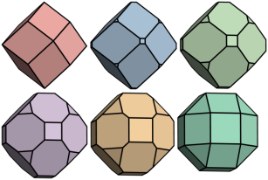
Chemical Potential, Free energies
Free Energy Barrier Height
Free Energy Barrier Height

Slide 47

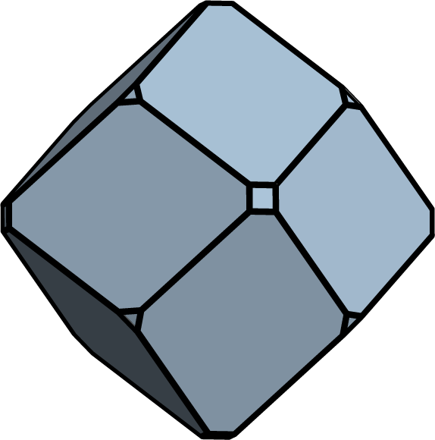
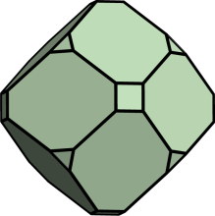
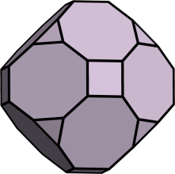
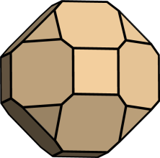
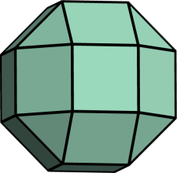

Potential Mean Force & Torque
PMFT data for the family (top row liquid, bottom solid).
Truncation undermines local ccp ordering

Slide 48
Conclusions: Paper 6
We show that the truncation of a rhombic dodecahedra which we knew should weakens the directional entropic forces between pairs of particles leads to higher free energy barriers at a given supersaturation
This provides more evidence that the local structural motifs in the fluid provided by the building block are essential for stabilizing nucleation pathways

Slide 49



Concluding remarks
Free Energy Barrier Height
Shapes effect both equilibrium assembles and their formation pathways

Slide 50


Slide 51
Method: Bipyr Local Directional Order
Algorithm:
For every particle
Find neighbors (rcut to find adjacent ~4)
Find bipyr tip with positive z component
Compute average x-y plane dot product with neighbors
Outcomes:
Order parameter, -1 is antiparallel, +1 parallel

Slide 52
Method: Global Axial Order
Algorithm:
For each particle i
Calculate xy plane angle theta)
Calculate c =exp(i*2*theta)
Calculate phase angle of c, add to list
Histogram phase angles
Calculate order parameter as variance of the bin heights
Output:
Histogram is ~uniform if liquid or many grains
Variance near zero
Histogram is sharply peaked if one or few grains
Variance Large, system has axial alignment

Slide 53
A diffusionless transformation
In N=4096 systems, the transition reliably (10 replicates, different seeds) undergoes the same transition path
Say we have a box matrix B₁ for the initial Monoclinic lattice with the dense 100 plane perpendicular to the z-axis, and a box B₂ after the transition to Minkowski.
For the larger systems, there exists T s.t. B₂ = T B₁
T= [0.9535 -0.0219 0.0618]
[0.0023 0.9486 -0.0206]
[0.0979 -0.0670 1.1132]
T describes how particle positions expand

Slide 54



PMFT

Slide 55


PMFT ‘Easy Assembling’ Shapes

Slide 56

Replace with Custom Slide excising useless subpanels micrographs.
Discuss Oct Separately

Slide 57
PMFT

